Slide 1

Methods of mark adjustment
28 May 2019

Slide 2
Methods of mark adjustment
Z-score normalisation
Quadratic scaling
Piecewise linear scaling

Slide 3
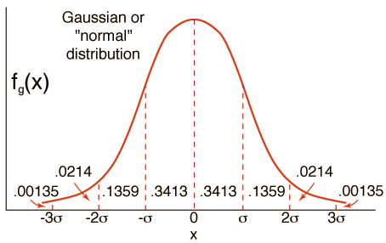
Z-score
Based on the assumption that the marks obtained by a cohort in a module or unit of assessment broadly follows a “normal” or Gaussian distribution.
ps://en.wikipedia.org/wiki/Normal_distribution

Slide 4
Z-score
With z-score normalisation one can…
Frequency
Mark

Slide 5
Z-score
…increase the mean…
Frequency
Mark

Slide 6
Z-score
….reduce the mean…
Frequency
Mark

Slide 7
Z-score
Or alternatively one can…
Frequency
Mark

Slide 8
Z-score
…reduce the standard deviation…
Frequency
Mark

Slide 9
Z-score
…or increase the standard deviation
Frequency
Mark

Slide 10
Z-score
One can adjust both the mean and standard deviation, as in this example:
Frequency
Note how the lowest marks have increased dramatically:
Mark

Slide 11
Quadratic scaling
Before any adjustment, all candidates fall on the line of equality (A=R):
Adjusted
mark
A = R
Raw mark

Slide 12
Quadratic scaling
Pick an ‘Actual’ point…
Adjusted
mark
A = R
Raw mark

Slide 13
Quadratic scaling
…and set its ‘Desired’ value, which can be an increase or (as shown here) a reduction:
Adjusted
mark
A = R
Raw mark

Slide 14
Quadratic scaling
A curve is then fitted that goes through the ‘Desired’ point and the end points (0% , 100%)
Adjusted
mark
A = R
The end points are preserved (anyone on 0% or 100% stays there).
The biggest adjustment is felt in the middle of the distribution.
Raw mark

Slide 15
Quadratic scaling
This is what an upward adjustment might look like …..
Adjusted
mark
A = R
The end points are preserved (anyone on 0% or 100% stays there).
The biggest adjustment is felt in the middle of the distribution.
Raw mark

Slide 16
Piecewise linear scaling
This method allows adjustment to be carried out in different parts of the mark distribution
Adjusted
mark
A = R
Raw mark

Slide 17
Piecewise linear scaling
Establish scaling points at normal ‘boundaries’ (e.g. Pass, Merit, and Distinction at Level 7):
Adjusted
mark
A = R
P M D
Raw mark

Slide 18
Piecewise linear scaling
Adjust one or more points up or down in value (e.g. move Pass to 40%):
Adjusted
mark
A = R
P M D
Raw mark

Slide 19
Piecewise linear scaling
Kink the line of equality to pass through the new point (or points, if more than one adjusted):
Adjusted
mark
A = R
P M D
Raw mark

Slide 20
Piecewise linear scaling
Note that P, M, D are in the original locations (e.g. 50, 60 and 70) on the Adjusted scale:
Adjusted
mark
A = R
D
M
P
P M D
Raw mark

Slide 21
Piecewise linear scaling
Here is another example in which Distinction is moved to 80%:
Adjusted
mark
A = R
P M D
Raw mark

Slide 22
Piecewise linear scaling
Again, kink the line of equality to pass through the new point:
Adjusted
mark
A = R
P M D
Raw mark

Slide 23
Piecewise linear scaling
Again, note that P, M, D are in the original locations (e.g. 50, 60 and 70) on the Adjusted scale
Adjusted
mark
A = R
D
M
P
P M D
Raw mark

Slide 24
Piecewise linear scaling
For Levels 4-6, four scaling points are required, at Pass, Lower 2nd, Upper 2nd and First:
Adjusted
mark
A = R
P L U F
Raw mark

